Slide 1


Liquidity Project
Victor Pyanykh Shalev Levi Sagzan
Project Advisor: Mr. Ofer Zevin

Slide 2

BACKGROUND
Overview of Stock Markets:
• Dynamic platform for buying and selling financial instruments.
• Essential for capital formation and wealth creation.
Transaction Mechanism:
• Orders executed through brokers and matched electronically.
• Market orders, limit orders, and stop orders affect price and quantity.
Transaction Book:
• Reflects supply and demand at various price levels.
• Highest bid and lowest ask prices establish the market price.

Slide 3

Problem Description
Liquidity Challenge:
• Tel Aviv stock market faces liquidity issues.
• Widened margins between buying and selling prices.
• Increased costs for buyers and sellers due to inaccurate share value reflection.
Impact:
• Hinders transaction efficiency.
• Deters market participants due to uncertainty and costs.

Slide 4

Project Objective
Primary Goal:
• Design and implement a machine learning algorithm to predict order execution and minimize spreads.
• Develop a user-friendly query interface for seamless data interaction.
Specific Aims:
• Forecast optimal buying and selling times (monthly, weekly, daily, hourly).
• Minimize the margin between transaction prices and actual share values.

Slide 5

Target Audience
ML Algorithm:
• Investment houses, pension funds, professional traders, venture capital funds.
Query Interface:
• Tel Aviv Stock Exchange employees.

Slide 6

Key Features
ML Algorithm:
• Predicts execution of buy/sell orders based on liquidity.
• Recommends optimal transaction timing to maintain minimal margin.
Query Interface:
• Filters transactions by paper number, quantity, date, and time.
• Queries transaction completion duration and margin from execution prices.

Slide 7

Adding Analytical Layers to the Research

Slide 8
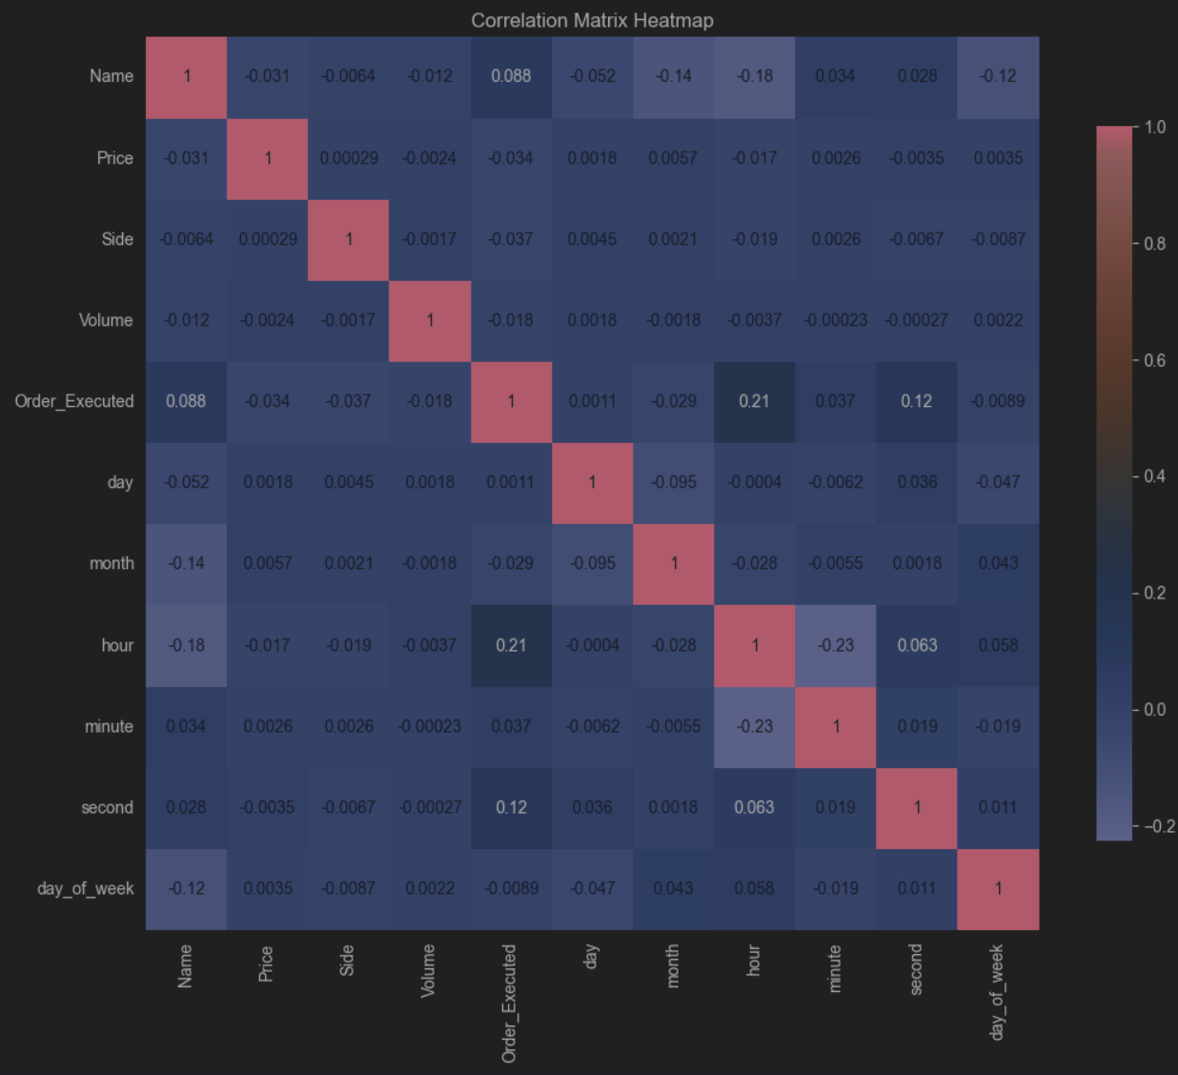

Slide 9
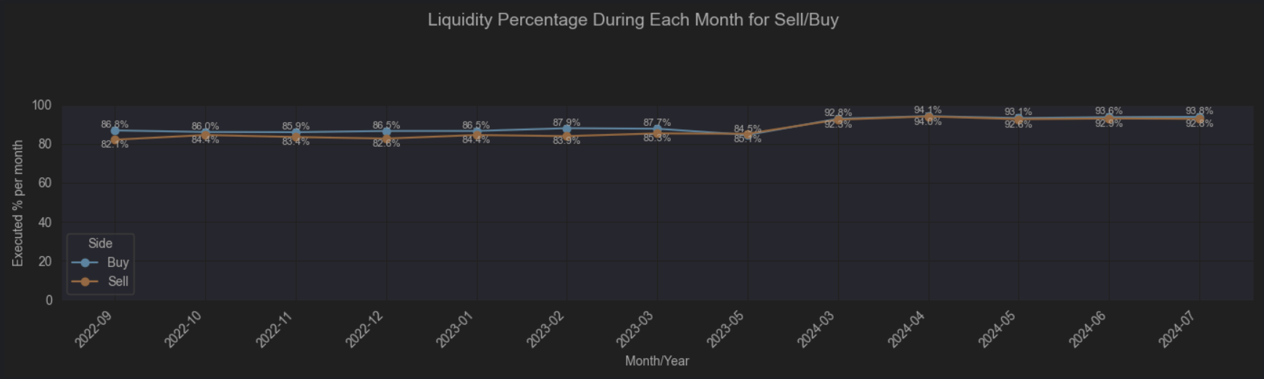

Slide 10
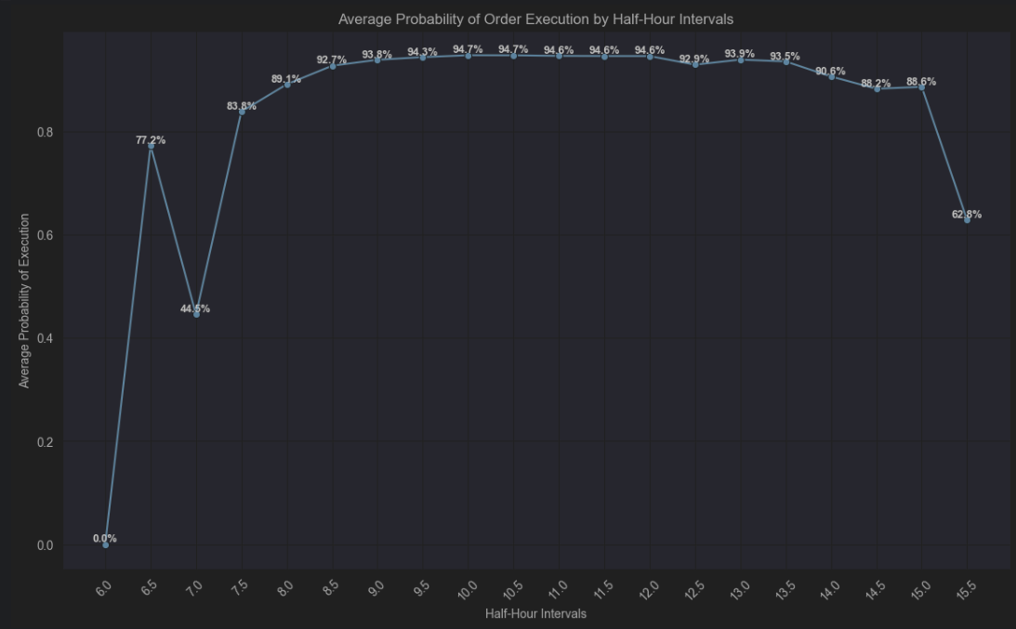

Slide 11
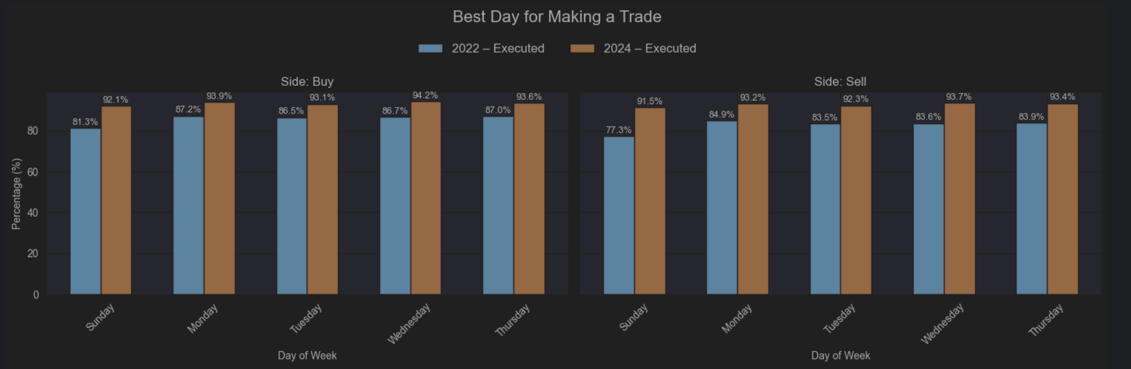

Slide 12
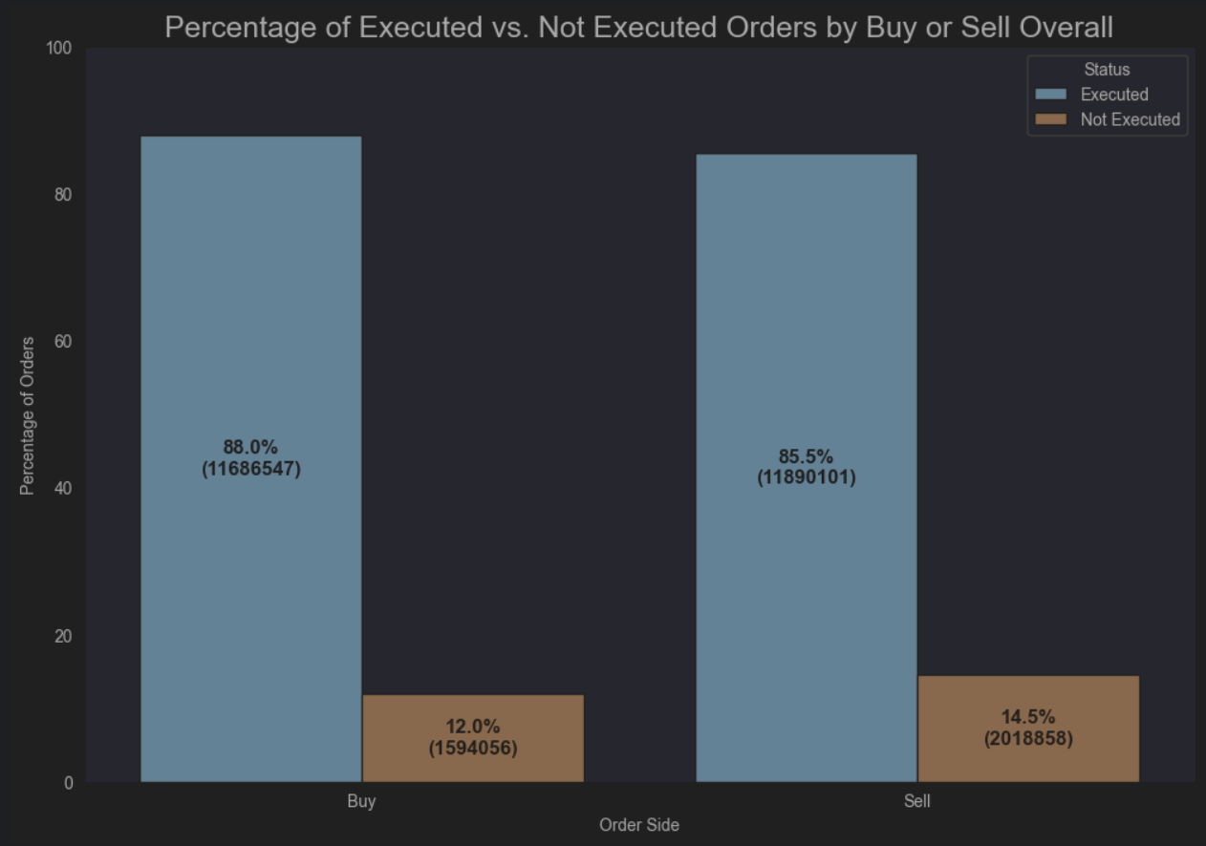

Slide 13

Classification
XGBoost
LightGBM
Linear Regression
SGD

Slide 14
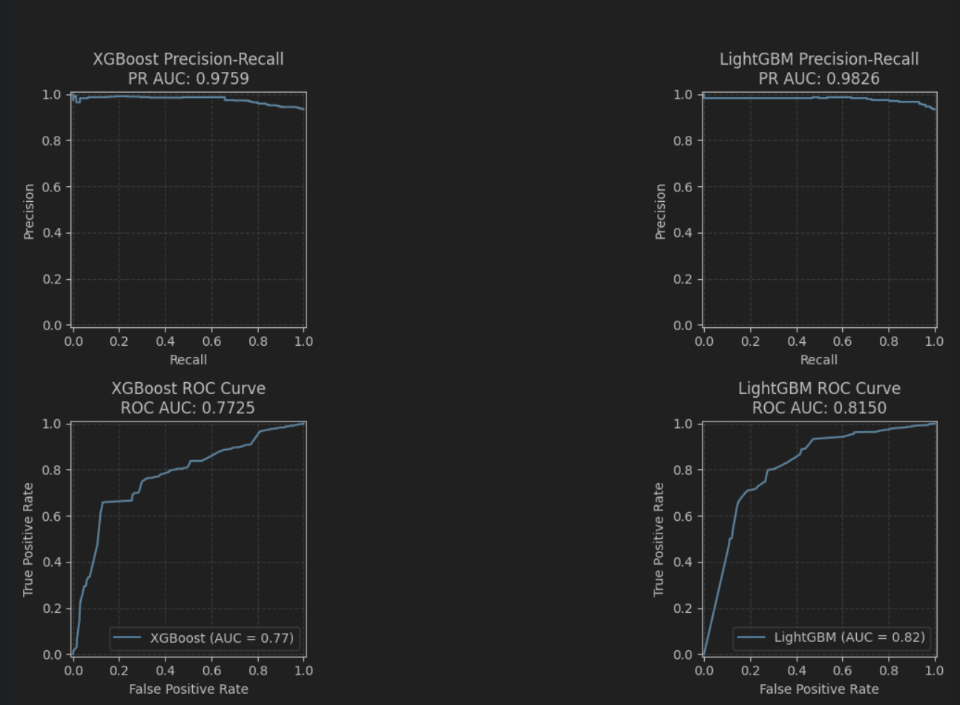
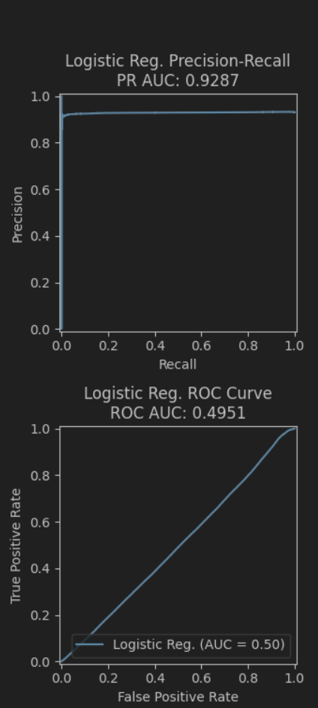
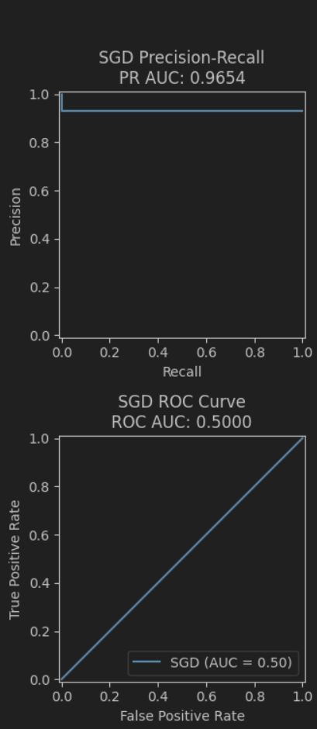

Slide 15
Summarize
Logistic Reg
Model
XGBoost
LightGBM
SGD
PR AUC
0.8132
0.9826
0.9287
0.9654
ROC AUC
0.7725
0.8150
0.4951
0.5000

Slide 16

Model Taken

Slide 17
Forecasting
XGBoost
LightGBM
LSTM
GRU
Linear Regression

Slide 18
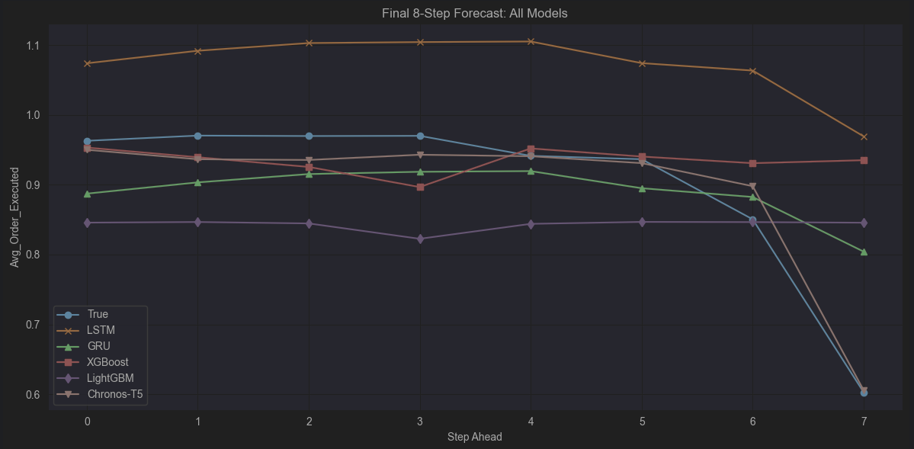

Slide 19
Summarize
Model
XGBoost
LightGSM
CHR T5
LSTM
GRU
MSE
0.0077
0.0159
0.0005
0.0360
0.0074
MAE
0.0478
0.0798
0.0193
0.1725
0.0681
R2
0.7285
0.4391
0.9614
-1.560
0.4700
MASE
12.687
21.059
3.9949
45.523
17.982
SMAPE
56.82
86.54
2.25
18.38
8.22
DW
0.19
0.10
0.46
0.11
0.60

Slide 20
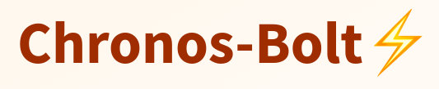
Model Taken

Slide 21
Thanks for listening!

